Slide 1

A random field…
http://dnsea.wikia.com/wiki/File:Random_Field_1.jpg

Slide 2

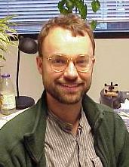
An Introduction to Conditional Random Fields
Charles Sutton and Andrew McCallum
Foundations and Trends in Machine Learning,
Vol. 4, No. 4 (2011) 267-373
Edinburgh
UMass

Slide 3
Additional Tutorial Sources
Hanna M. Wallach (2004). “Conditional Random Fields: An Introduction.” Technical Report MS-CIS-04-21. Department of Computer and Information Science, University of Pennsylvania.
Easy to follow, provides high-level intuition. Presents CRFs as undirected graphical models (as opposed to undirected factor graphs).
Charles Sutton and Andrew McCallum (2006). “An Introduction to Conditional Random Fields for Relational Learning.” In Introduction to Statistical Relational Learning. Edited by Lise Getoor and Ben Taskar. MIT Press, 2006
Shorter version of the book.
Rahul Gupta (2006). “Conditional Random Fields.” Unpublished report, IIT Bombay.
Provides detailed derivation of the important equations for CRFs
Roland Memisevic (2006). “An Introduction to Structured Discriminative Learning.” Technical Report, University of Toronto.
Places CRFs in the context of other methods for learning to predict complex outputs, esp. SVM-inspired large-margin methods.
Charles Elkan (2013). “Log-linear models and CRFs”
http://cseweb.ucsd.edu/users/elkan/250B/loglinearCRFs.pdf

Slide 4
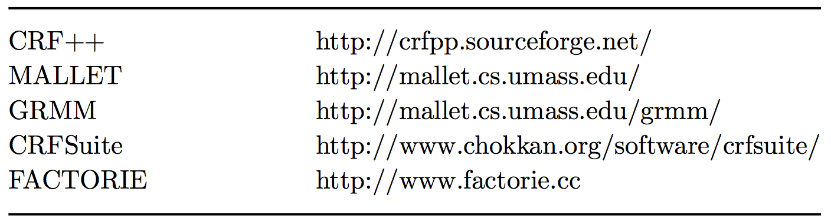
Code
Internet country code for the Cocos (Keeling) Islands, an Australian territory of 5.4 square miles and about 600 inhabitants.
Administered by VeriSign (through subsidiary eNIC), which promotes .cc for international registration as “the next .com”

Slide 5
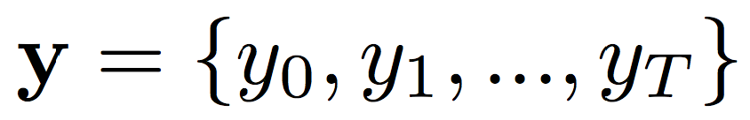
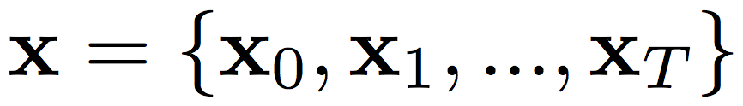
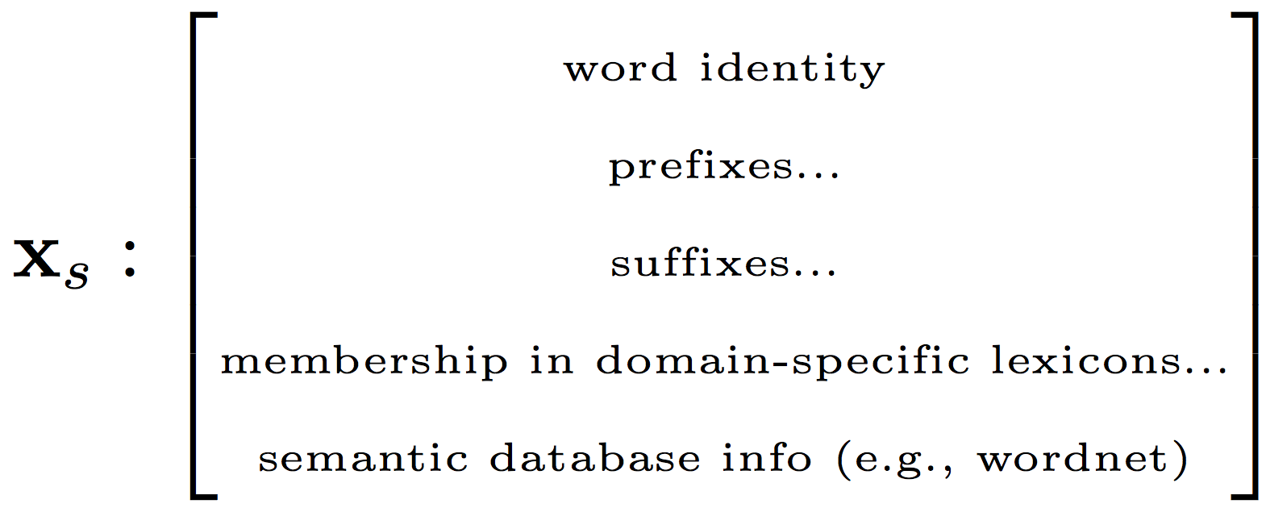
A Canonical Example: POS Tagging
http://cogcomp.cs.illinois.edu/demo/pos/
PRP VB RB VBN IN DT JJ NN RB VBZ RP WP VBD IN DT NNP NNP
“I’ll be long gone before some smart person ever figures out what happened inside this Oval Office.”
(George W. Bush, Washington D.C., May 12, 2008)

Slide 6
Two Views
The Generative Picture
The Discriminative Picture
Y
P(Y)
Y
P(X|Y)
P(Y|X)
X
Can infer [label, latent state, cause] from evidence using Bayes Thrm
P(Y|X) = P(X|Y) P(Y) / P(X)
X
Model the Joint of X and Y
P(X,Y) = P(X|Y) P(Y)

Slide 7
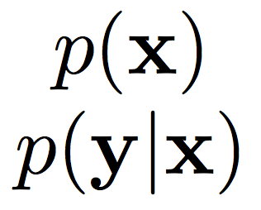
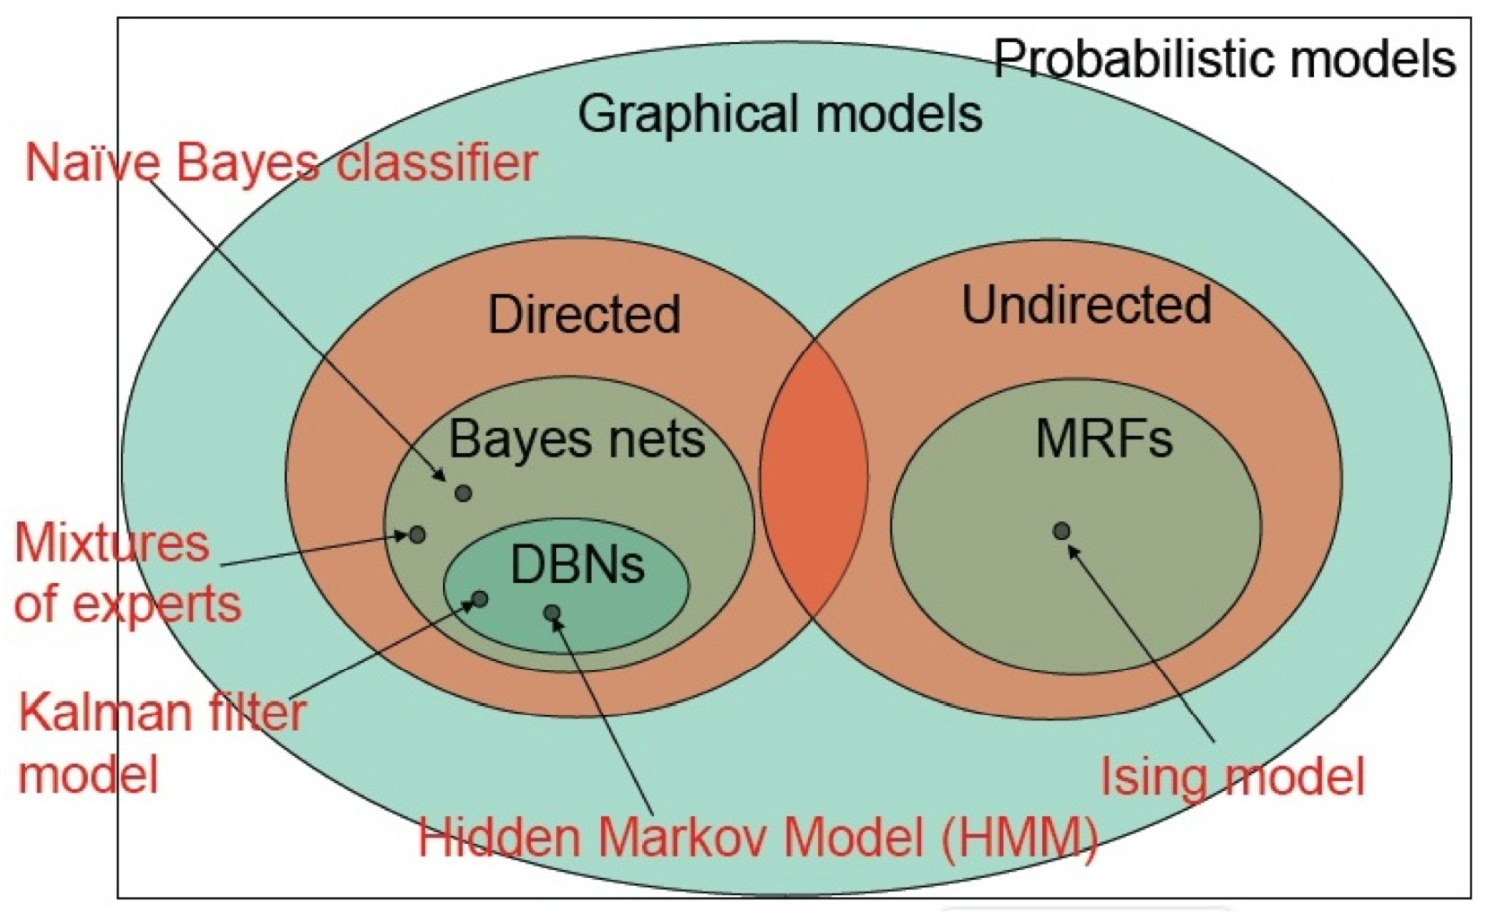
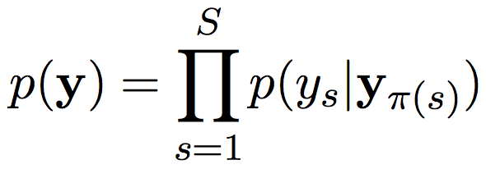
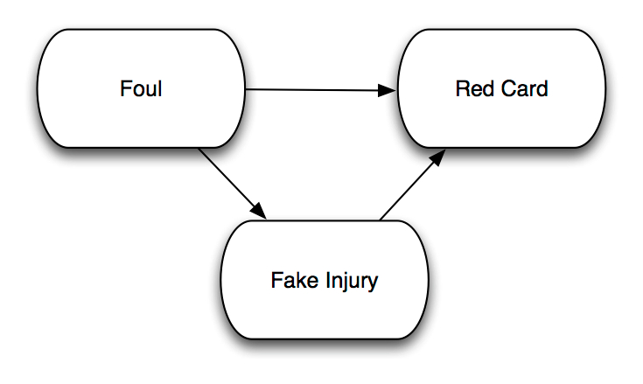
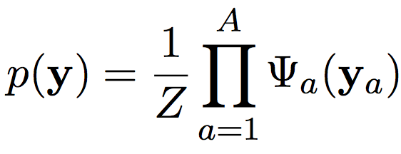
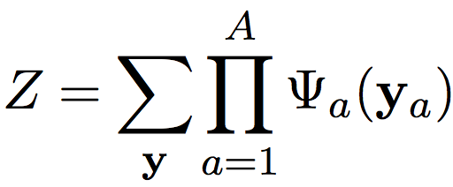
Graphical Models
Factorization
(local functions)
Conditional
Independence
Graphical Structure
(relational structure of factors)
Directed Graphical Models
Undirected Graphical Model

Slide 8
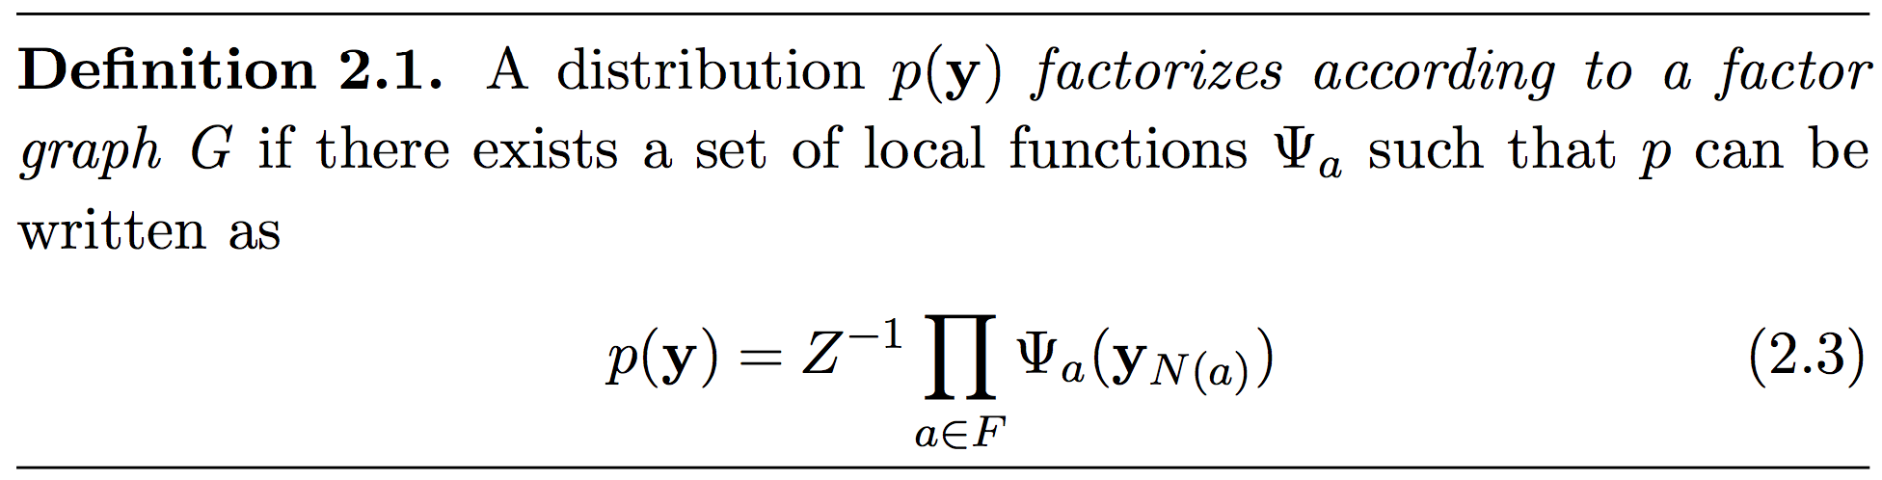
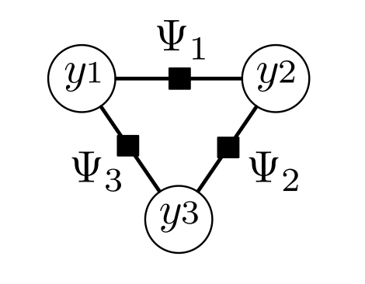
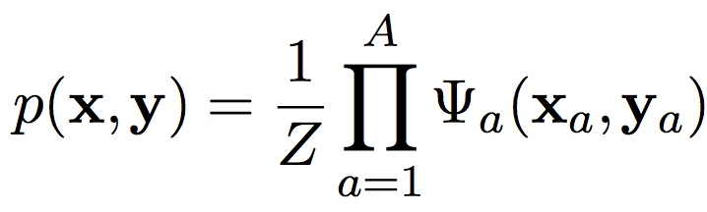
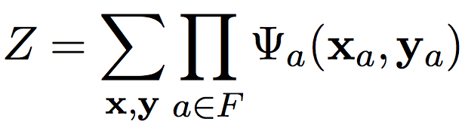
Factor Graphs
Distinguish “input” (always observed)
from “output” (wish to predict)

Slide 9
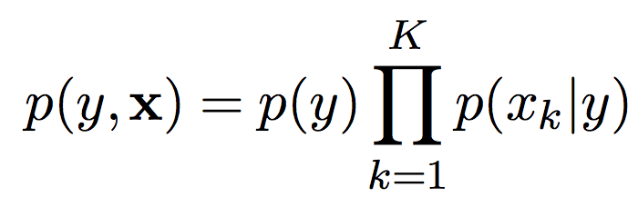
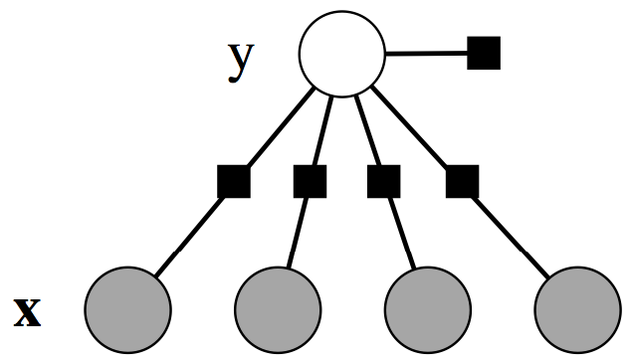
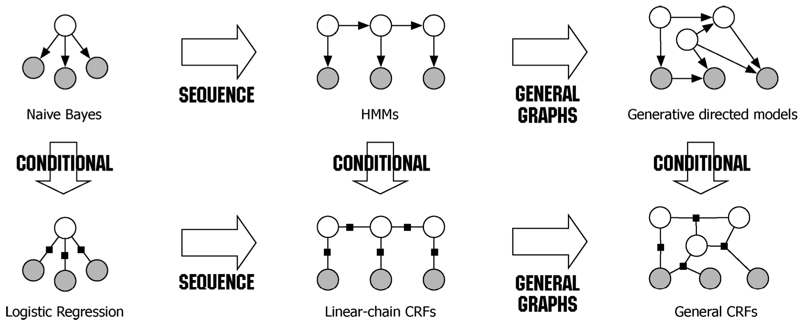
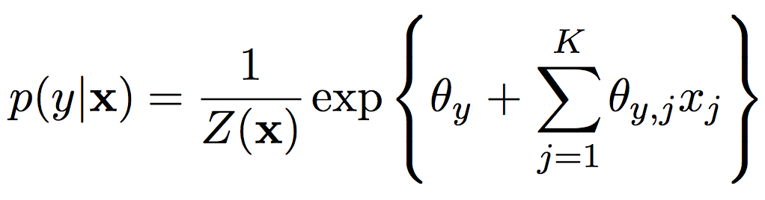
Generative-Discriminative Pairs

Slide 10
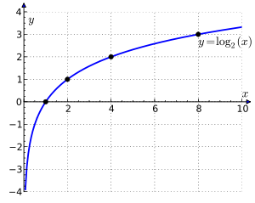
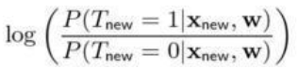
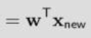
Binary Logistic Function
The logistic likelihood is formally derived as a result of modeling the log-odds ratio (aka the logit):
There are no constraints on this value: it can take any real value.
Large negative
Large positive

Slide 11
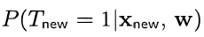
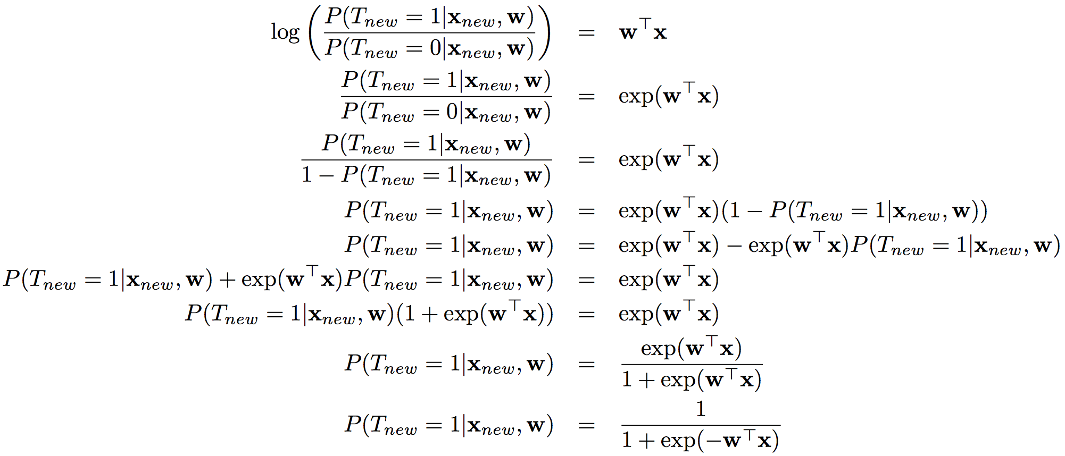
Binary Logistic Function
Example of a generalized linear model: linear model passed through a transformation to model a quantity of interest.
Now, derive
Note:
The Logit
The binary logistic function is really modeling the log-odds ratio with a linear model!
The Logistic (likelihood)
function

Slide 12
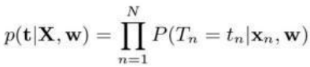
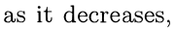
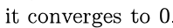
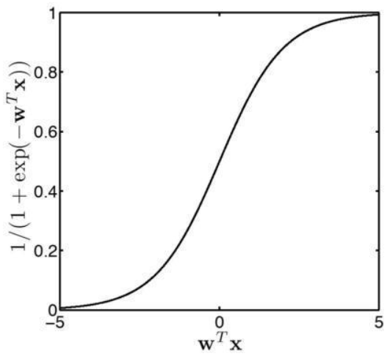
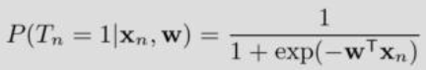
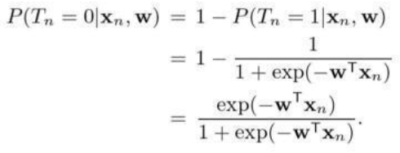
Binary Logistic Likelihood
The Logistic (or Sigmoid) function
Linear component
When target is 0:
Combine both into a single probability function
(Note! A fn of x)

Slide 13
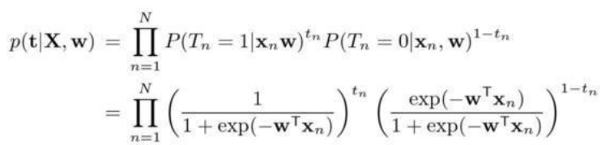
Binary Logistic Likelihood
Substitute in the component likelihoods to get the final likelihood function
“Multinomial” Logistic Likelihood:

Slide 14
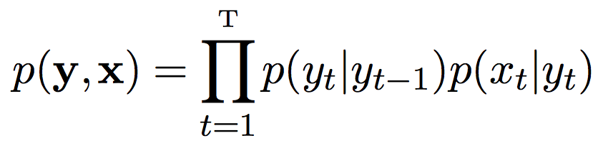
Generative-Discriminative Pairs

Slide 15
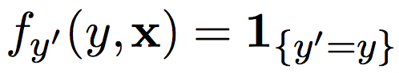
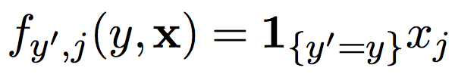
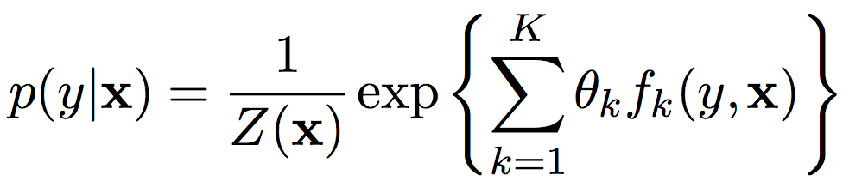
Feature Functions
for bias
for feature weights

Slide 16
Section 2.2.3
Read pp.281-286 for nice discussion comparing strengths and weaknesses of generative and discriminative approaches.

Slide 17
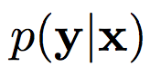
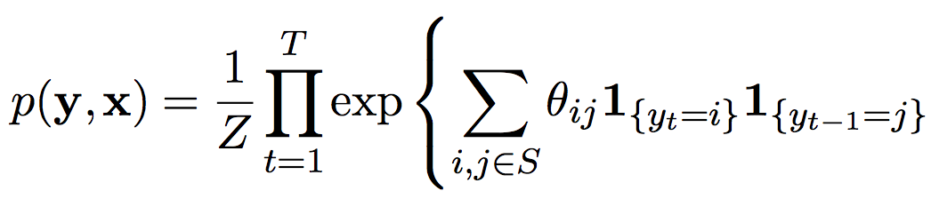
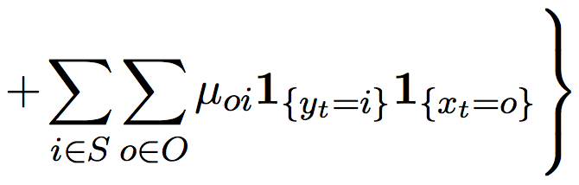
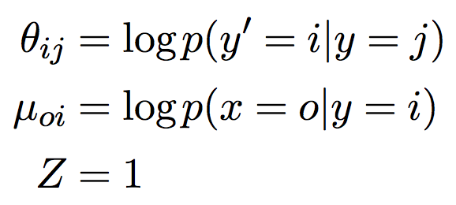
From HMM to Linear-Chain CRF
The conditional distribution is in fact a CRF with particular choice of feature functions
Every homogeneous HMM can be written in this form by setting…

Slide 18
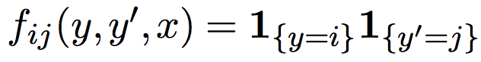
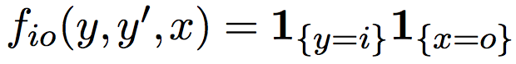
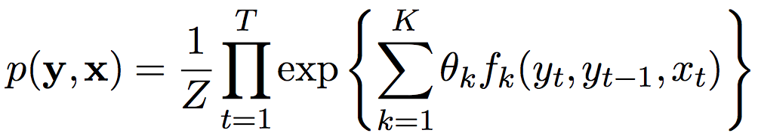
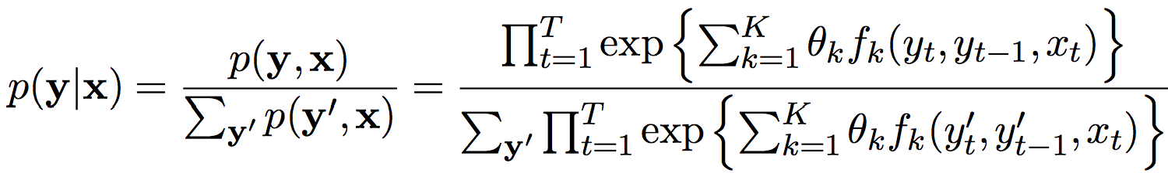
Rewrite with Feature Functions
Now, the conditional distribution:

Slide 19
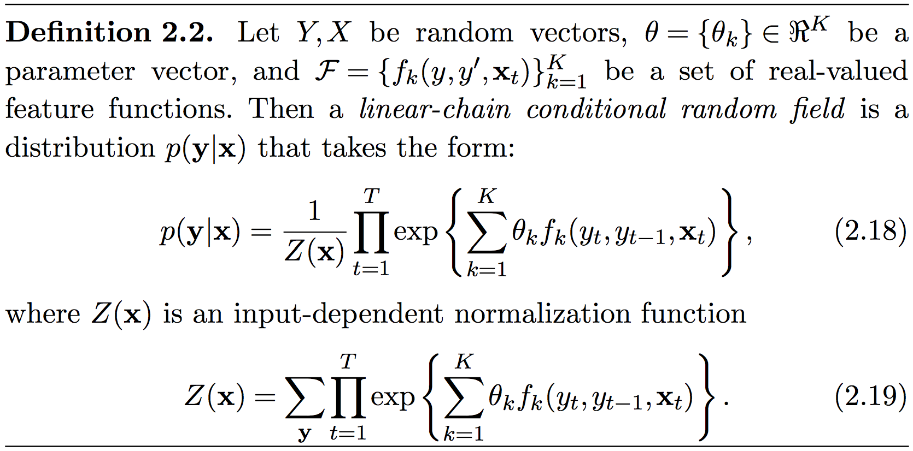
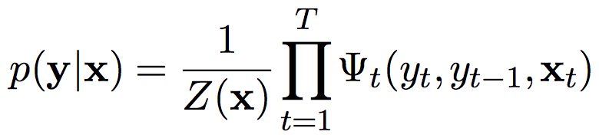
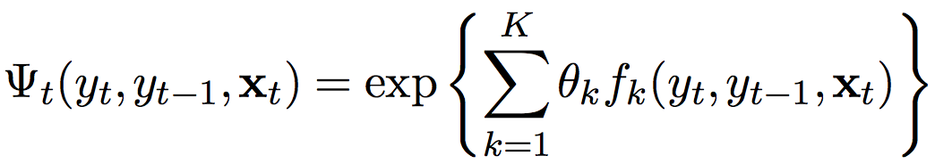
The Linear Chain CRF
As a factor graph…
… where each factor has this fnl form

Slide 20
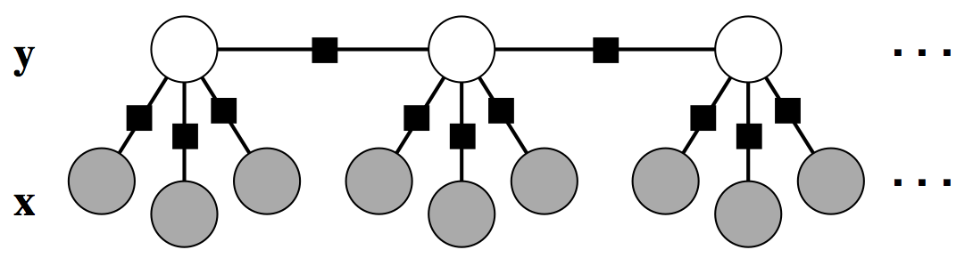
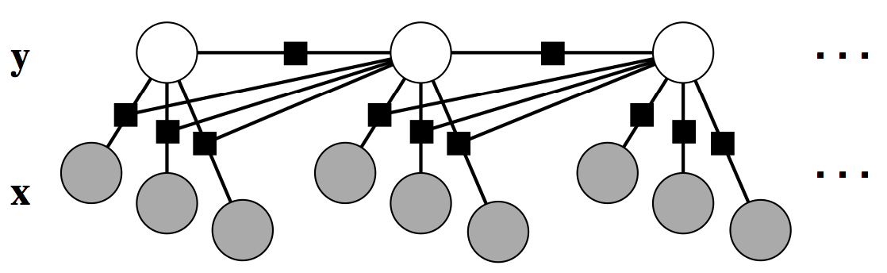
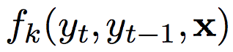
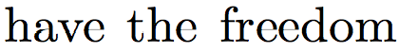

Variants of the Linear Chain CRF
The “HMM-like” LCCRF

Slide 21




General CRFs

Slide 22

Clique Templating

Slide 23



Feature Engineering
(1) Label-observation features
discrete

Slide 24


Feature Engineering
(2) Unsupported Features
Explicitly represent when a rare feature is not present
Assign negative weight
Early large-scale CRF application had 3.8 million binary features
Results in slight increase in accuracy
but permits many more features

Slide 25



Feature Engineering
(3) Edge-Observation / Node-Observation

Slide 26

Feature Engineering
(4) Boundary Labels

Slide 27

Feature Engineering
(5) Feature Induction (extend “unsup ftr trick”)

Slide 28

Feature Engineering
(6) Categorical Features
Text applications: CRF features are typically binary
Vision and speech: typically real-valued
For real-valued features: helps to normalize (mean 0, stdev 1)

Slide 29

Feature Engineering
(7) Features from Different Time Steps

Slide 30
Feature Engineering
(8) Features as Backoff

Slide 31
Feature Engineering
(9) Features as Model Combination

Slide 32
Feature Engineering
(10) Input-Dependent Structure

